Slide 1
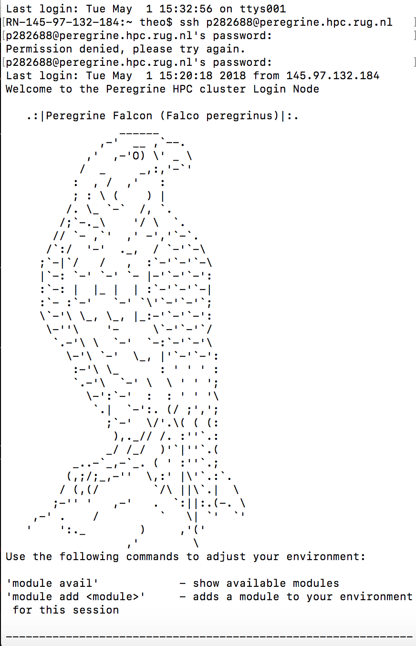

Slide 2
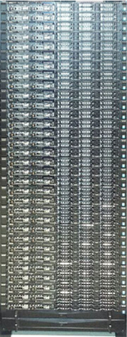
Send scripts
(You)
Collect results

Slide 3
I. Enter the cluster
Connect to Peregrine
Navigate in Peregrine
Exchange files w/ Peregrine
II. Run jobs on the cluster
Create a job script
Run a job script
Control your job’s status

Slide 4
Part I – Connect to Peregrine
ssh <S-number>@peregrine.hpc.rug.nl
and type your usual password !
You land on your home directory
/home/$USER
but you can also have a directory on /data (more storage)
/data/$USER

Slide 5
Part I – Navigate in the command line
List all files (in the current directory) : command ls
ls
Make a directory : command mkdir
mkdir my_directory
Remove a directory : command rmdir
rmdir my_directory
Change directory : command cd
cd <directory>
cd my_directory
cd <path>
cd my_directory/sub_directory
cd home/$USER/my_directory/sub_directory
.. points to the upper directory
. points to the current directory
~ points to the root (/home/$USER)
Lost ? Command print working directory
pwd

Slide 6
Part I – Navigate in the command line
Handling simple files
Add lines to a script
echo “<text>” > my_script.txt
This creates a new script containing the text
echo “<text>” >> my_script.txt
This adds the text to an existing script
Print the content of a script to the screen
cat my_script.txt
Open & edit a script
nano my_script.txt
(Use Ctrl + the corresponding key to access options)

Slide 7
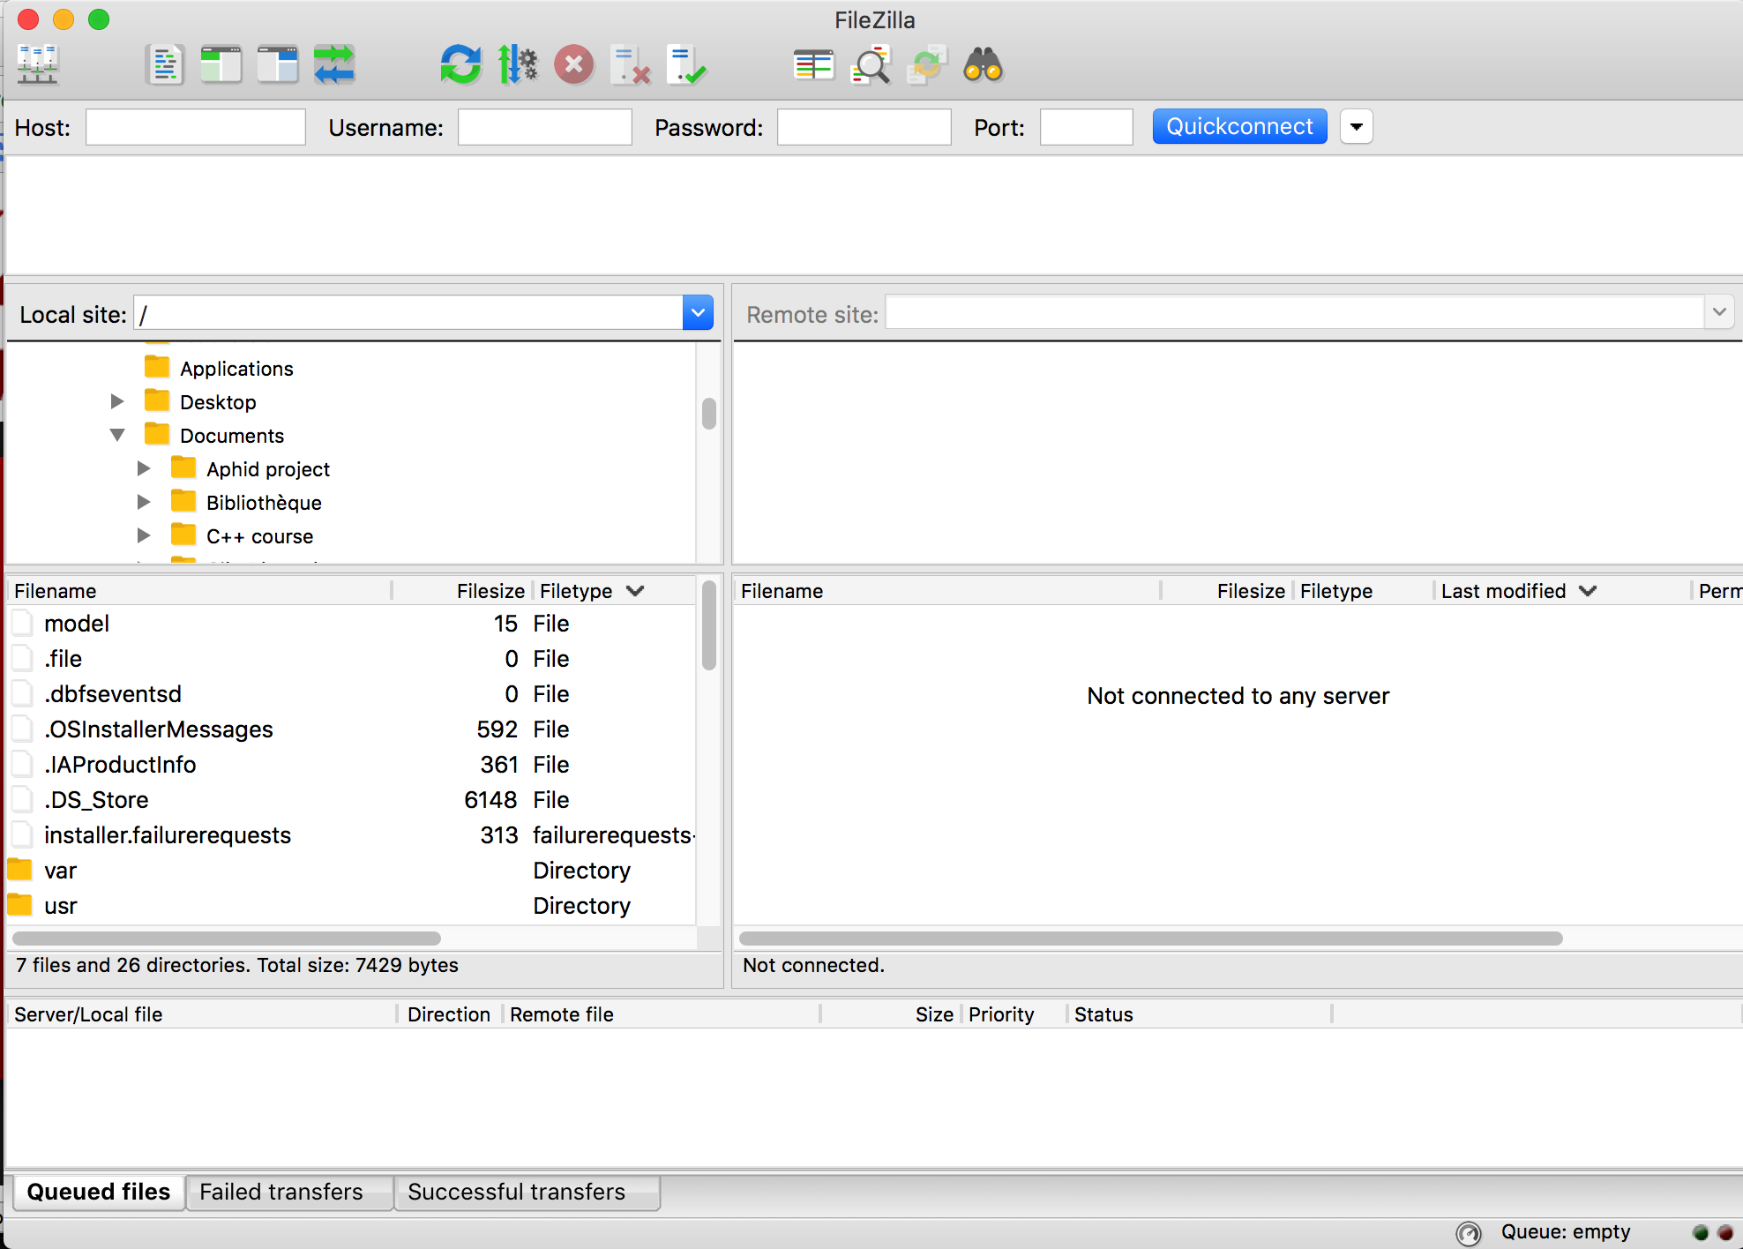
Part I – Exchange files with Peregrine
Use a File Transfer Client
e.g. FileZilla
MobaXTerm also contains one

Slide 8
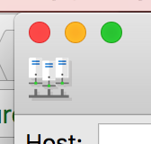
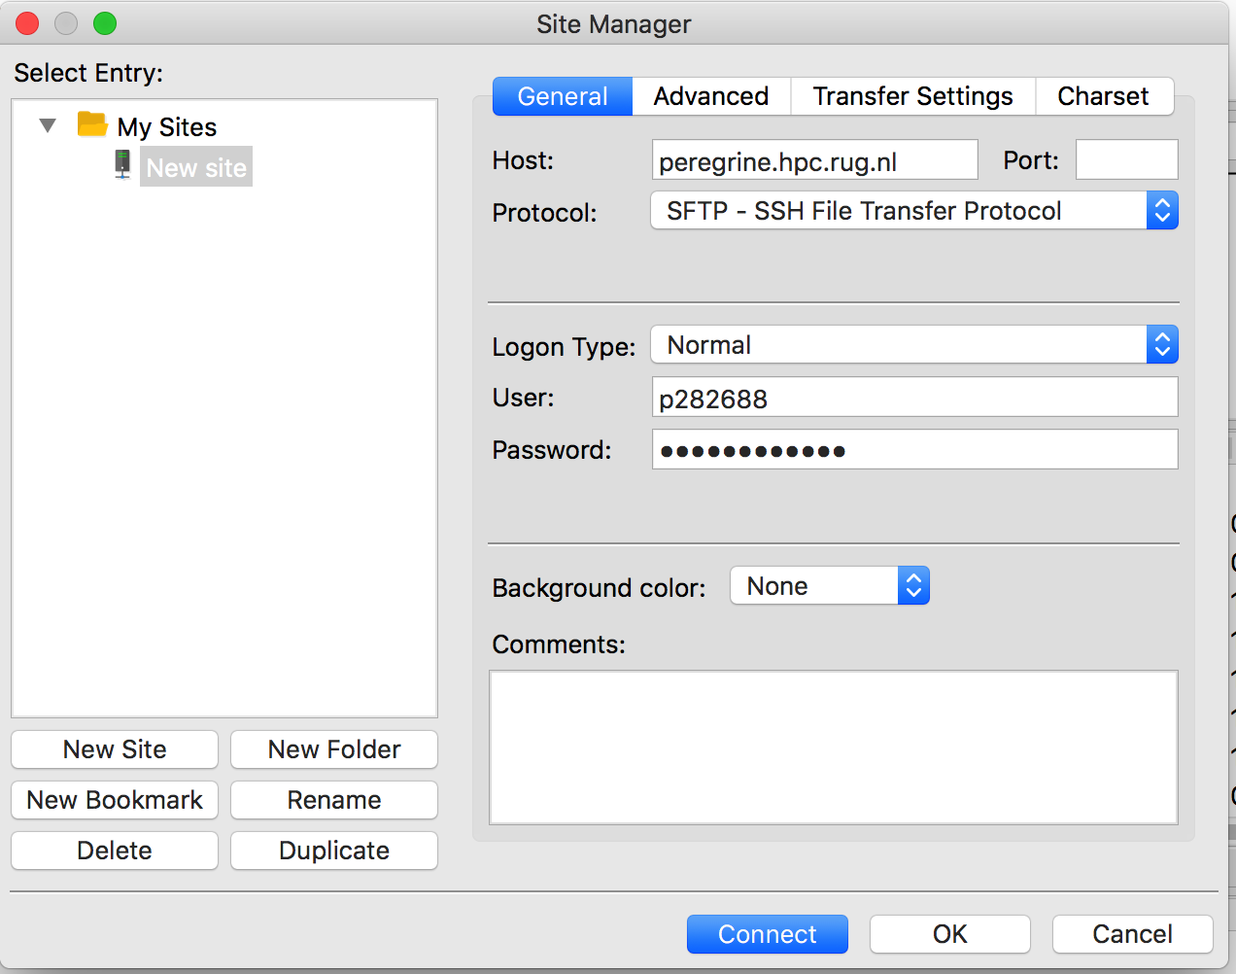
Part I – Exchange files with Peregrine
Connect to Peregrine

Slide 9
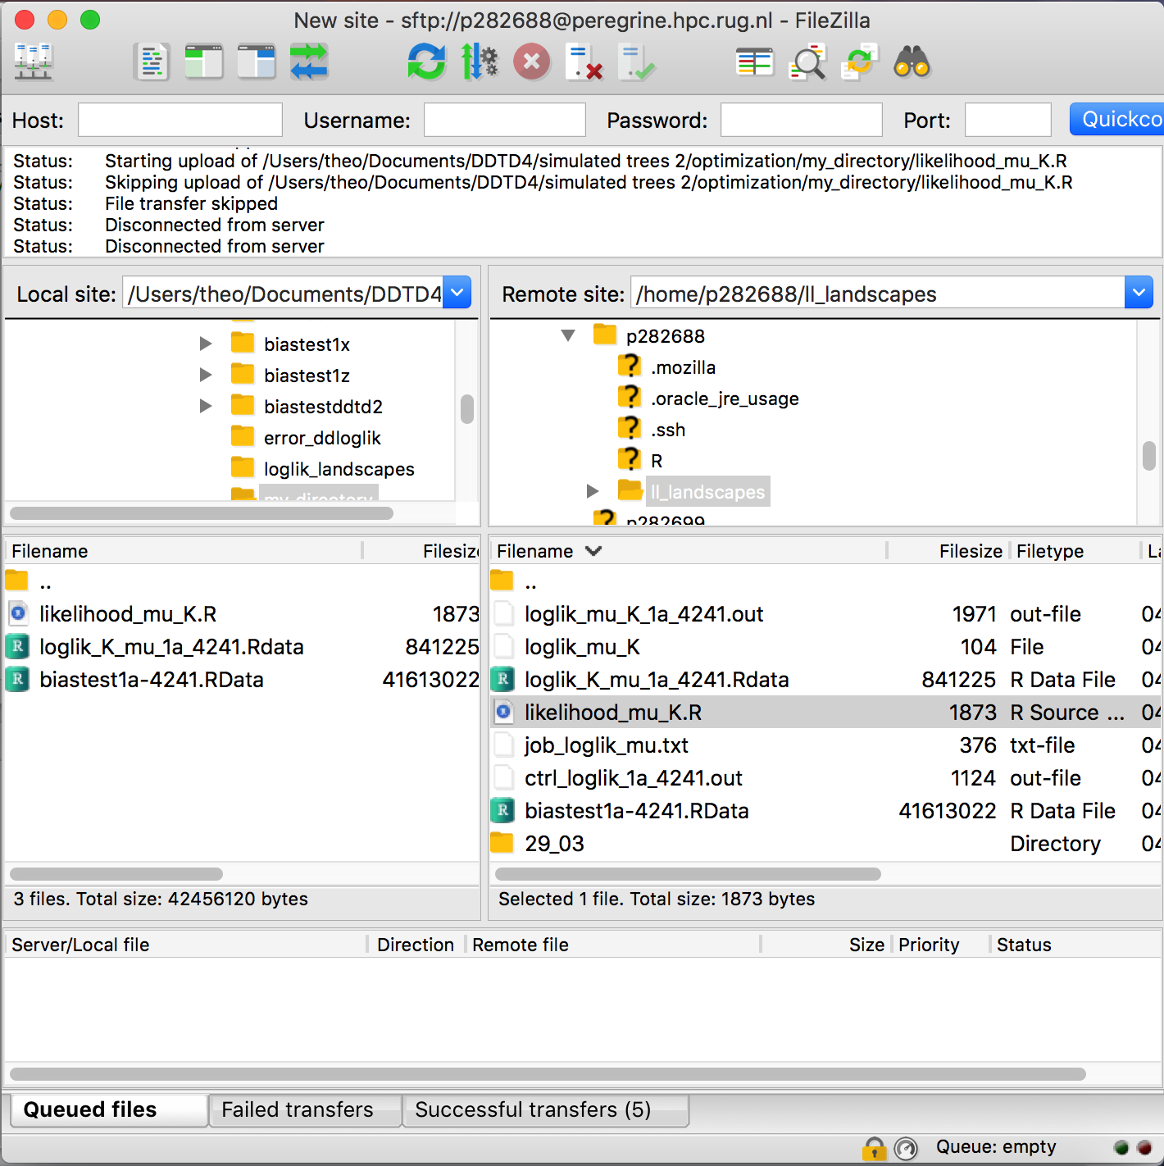
Part I – Exchange files with Peregrine
No auto-update !
History
Local directory
Cluster directory
Ongoing transfers

Slide 10
Part II – Run your R scripts !
R is not pre-loaded…
module load R
Run a .R script
Rscript <scriptname>.R
But doing this runs on the interactive node
(= entrance), not in the actual nodes of the cluster
Ok for short jobs e.g. to tidy data& scripts or run some small tests…
But NOT for long jobs (shared machine)

Slide 11
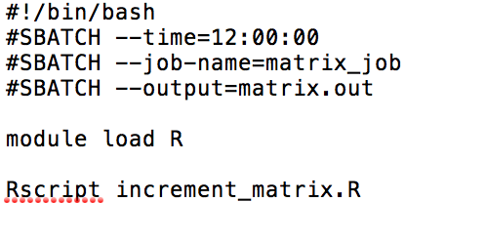
Part II – Run your R scripts !
Use job scripts to request your job to run
= a .bash or .txt file containing instructions
Shebang! + interpretor
Options
Content

Slide 12
Part II – Run your R scripts !
Shebang! + interpretor
Options
#SBATCH --ntasks=<N> for parallel processing
#SBATCH --mem=<N> (default in MB)
Send a mail when the job Is completed
#SBATCH --mail-user <mail@rug.nl>
#SBATCH --mail-type END

Slide 13
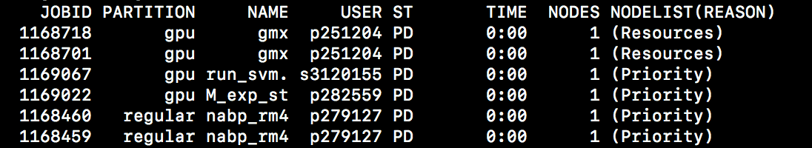
Part II – Run your R scripts !
Submit your job using
sbatch <filename>
Job ID !
Submitted batch job 1169514
You can check your job using squeue
squeue - status of all jobs
squeue –u $USER - status of your jobs
squeue <jobID> - status of a given job
Status
'PD : pending, waiting to run
R : running
Can’t find you job in the list ?
Probably completed or crashed.
Go check this .out !

